Slide 1

PANDAS

Slide 2
PANDAS :
Pandas stands for “Python for Data Analysis” .
Pandas packages can be imported as import pandas as pd
Pandas is an open-source, BSD-licensed Python library providing high-performance, easy-to-use data structures and data analysis tools for the Python programming language. Python with Pandas is used in a wide range of fields including academic and commercial domains including finance, economics, Statistics, analytics, etc.

Slide 3
It is the most popular tool for data cleaning and analysis ,pandas can do the things very fast and easy.
Pandas Adopted Many coding styles from NumPy.
Pandas also gives preference for data processing without loops.
Pandas works with data frames and series.
Pandas is best suited for working with Tabular or Heterogeneous functions.
Uses less memory
It is very fast because of Numpy

Slide 4
Environment Setup
Standard Python distribution doesn't come bundled with Pandas module. A lightweight alternative is to install Pandas using popular Python package installer, pip.
Pandas deals primarily 2 types of data structures: (very important) .
Series : It Is A 1 D Array With Indexes , It Stores A Single Column Or Row Of Data In A Dataframe. Or Series Is A 1 D Array Capable Of Holding Any Type Of Data )
DataFrame : It is A Tabular Spreads Sheets Like Structure Representing Rows Each Of Which Contains One Or Multiple Columns. Or Dataframe Is A 2 D Data Structure With Columns Of Potentially Different Types Of Data

Slide 5
Why pandas, why not Excel ?
Using pandas with Microsoft Excel can give you the best of both worlds and optimize your workflow.
Analyze Large Data Sets Easily
Import Datasets in Either HTML, CSV, and SQL Formats
Clean Up and Organize Data Sets
Why Should you use pandas and excel together?
The best course of action is actually to use Microsoft Excel and Python pandas together. When working with smaller data sets it is best to stick with Excel’s easy-to-use interface.
Since pandas is so versatile — even if we start your analysis in Excel we can easily import it over to Python and continue. we can also always start in pandas and use the software to clean up and organize your data, and then move over to Excel to visualize it easier. Pandas’ adaptability makes a switch between the two a breeze. we can perform the easy calculations in Excel, then use pandas’ more complex programs to dive in deep.

Slide 6
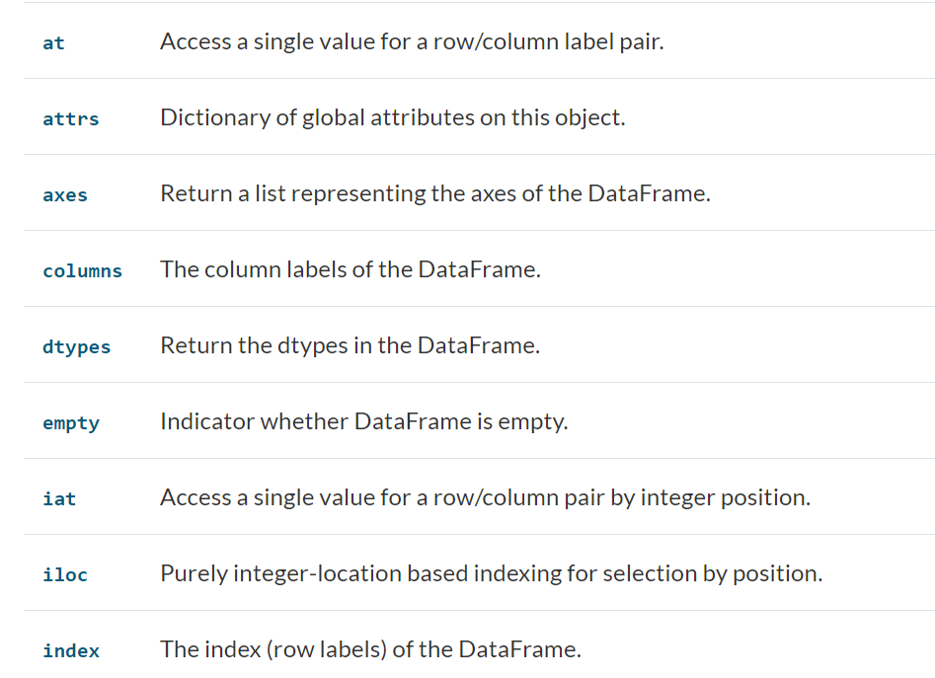
INBUILT ATTRIBUTE:

Slide 7
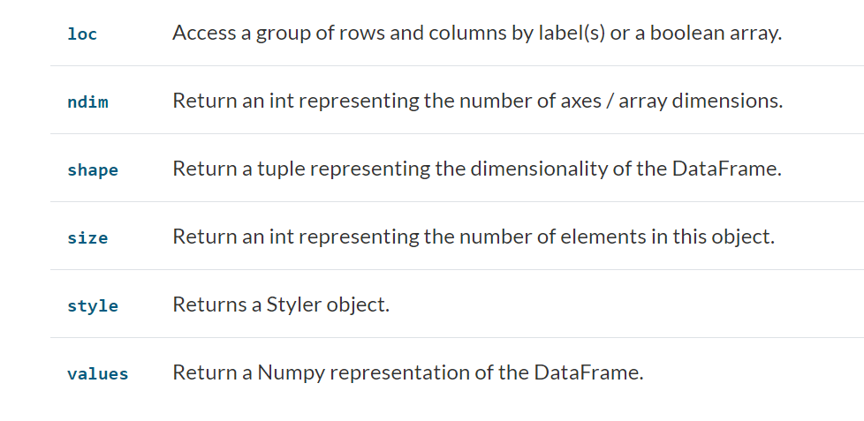
INBUILT ATTRIBUTE:

Slide 8
MATPLOTLIB
Matplotlib is a collection of functions that make matplotlib work like MATLAB. Each pyplot func makes some changes to a figure: eg. Creates a fig. , creates a ploting area in a figures, plots some lines in a plotting area and decorates the plot with labels, etc.

